Slide 1
Ensemble Techniques

Slide 2
Agenda
Introduction to Ensemble Methods
Types of Ensemble Techniques
Random Forest
AdaBoost
XGBoost

Slide 3
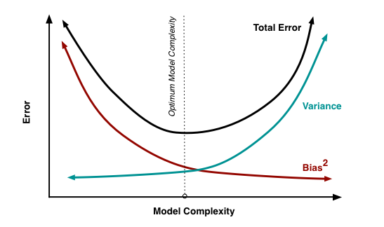
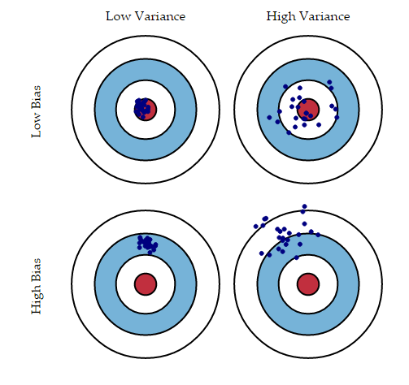
Introduction to Ensemble Techniques
Ensemble methods is a machine learning technique that combines several base models in order to produce one optimal predictive model. It is one of the ways to trade-off between bias and variance.
Reference - https://www.analyticsvidhya.com/

Slide 4
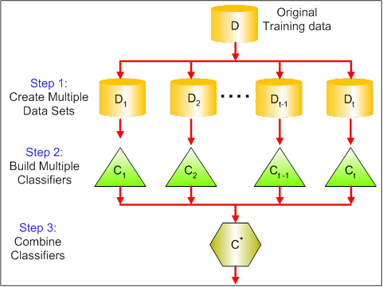
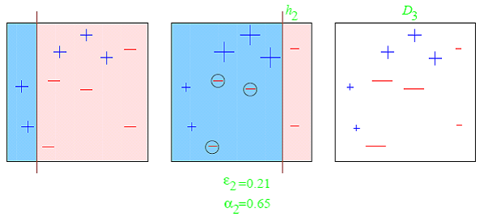
Types of Ensemble Techniques
Bagging - implement similar learners on small sample populations and then takes a mean of all the predictions
Boosting - iterative technique which adjust the weight of an observation based on the last classification
Stacking - multiple ML algorithms are used. Idea is to train ML algorithms with original training data and then generate a new dataset with these models. Then this new dataset is used as input for the final machine learning algorithm.
Reference - https://www.analyticsvidhya.com/

Slide 5
Random Forest
Random subsets are created from the original dataset (bootstrapping)
At each node in the decision tree, only a random set of features are considered to decide the best split
A decision tree model is fitted on each of the subsets
The final prediction is calculated by averaging the predictions from all decision trees
Reference - https://www.analyticsvidhya.com/

Slide 6
Random Forest
n_estimators:
It defines the number of decision trees to be created in a random forest.
Generally, a higher number makes the predictions stronger and more stable, but a very large number can result in higher training time.
max_features :
It defines the maximum number of features allowed for the split in each decision tree.
Increasing max features usually improve performance but a very high number can decrease the diversity of each tree.
max_depth:
Random forest has multiple decision trees. This parameter defines the maximum depth of the trees.
min_samples_leaf:
This defines the minimum number of samples required to be at a leaf node.
Smaller leaf size makes the model more prone to capturing noise in train data.
n_jobs:
This indicates the number of jobs to run in parallel.
Set value to -1 if you want it to run on all cores in the system.
random_state:
This parameter is used to define the random selection.
It is used for comparison between various models.
Reference - https://www.analyticsvidhya.com/

Slide 7
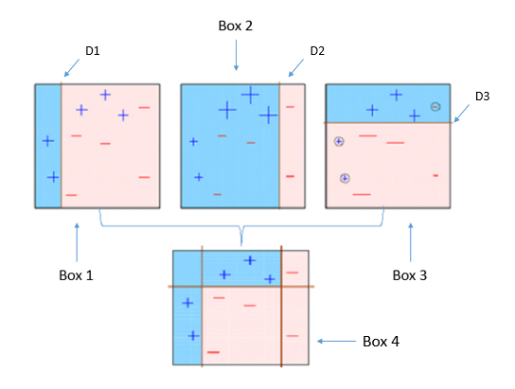
AdaBoost
Initially, all observations in the dataset are given equal weights.
A model is built on a subset of data
Using this model, predictions are made on the whole dataset
Errors are calculated by comparing the predictions and actual values
While creating the next model, higher weights are given to the data points which were predicted incorrectly
Weights can be determined using the error value. For instance, higher the error more is the weight assigned to the observation
This process is repeated until the error function does not change, or the maximum limit of the number of estimators is reached

Slide 8
AdaBoost
base_estimators:
It helps to specify the type of base estimator, that is, the machine learning algorithm to be used as base learner.
n_estimators:
It defines the number of base estimators.
The default value is 10, but you should keep a higher value to get better performance.
learning_rate:
This parameter controls the contribution of the estimators in the final combination.
There is a trade-off between learning_rate and n_estimators.
max_depth:
Defines the maximum depth of the individual estimator.
Tune this parameter for best performance.
n_jobs:
This indicates the number of jobs to run in parallel.
Set value to -1 if you want it to run on all cores in the system.
random_state:
This parameter is used to define the random selection.
It is used for comparison between various models.
Reference - https://www.analyticsvidhya.com/

Slide 9
XGBoost
GBM/ XGBoost handles the missing data on its own and does not require us to handle it explicitly
We want to predict a person’s age based on whether they play video games, enjoy gardening, and their preference on wearing hats.
Our objective is to minimize squared error. We have these nine training samples to build our model.
PersonID | Age | LikesGardening | PlaysVideoGames | LikesHats
1 | 13 | FALSE | TRUE | TRUE
2 | 14 | FALSE | TRUE | FALSE
3 | 15 | FALSE | TRUE | FALSE
4 | 25 | TRUE | TRUE | TRUE
5 | 35 | FALSE | TRUE | TRUE
6 | 49 | TRUE | FALSE | FALSE
7 | 68 | TRUE | TRUE | TRUE
8 | 71 | TRUE | FALSE | FALSE
9 | 73 | TRUE | FALSE | TRUE
Feature | FALSE | TRUE
LikesGardening | {13, 14, 15, 35} | {25, 49, 68, 71, 73}
PlaysVideoGames | {49, 71, 73} | {13, 14, 15, 25, 35, 68}
LikesHats | {14, 15, 49, 71} | {13, 25, 35, 68, 73}
Reference - https://www.gormanalysis.com/

Slide 10
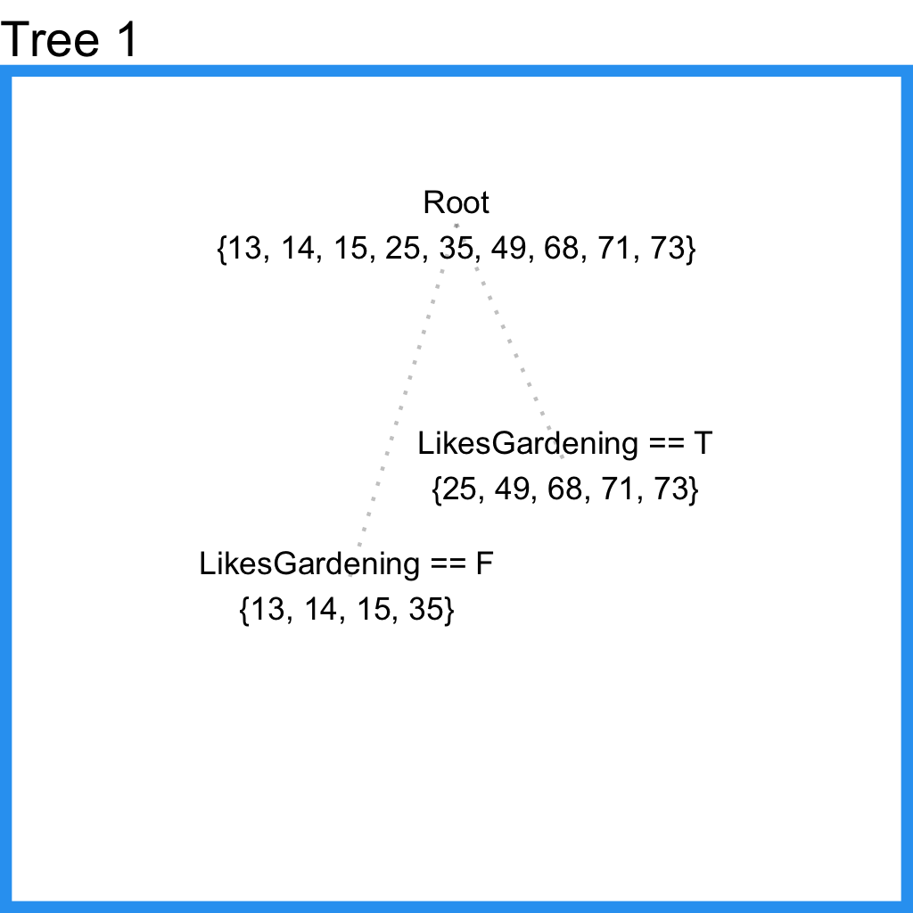
XGBoost
PersonID | Age | Tree1 Prediction | Tree1 Residual
1 | 13 | 19.25 | -6.25
2 | 14 | 19.25 | -5.25
3 | 15 | 19.25 | -4.25
4 | 25 | 57.2 | -32.2
5 | 35 | 19.25 | 15.75
6 | 49 | 57.2 | -8.2
7 | 68 | 57.2 | 10.8
8 | 71 | 57.2 | 13.8
9 | 73 | 57.2 | 15.8
Reference - https://www.gormanalysis.com/

Slide 11
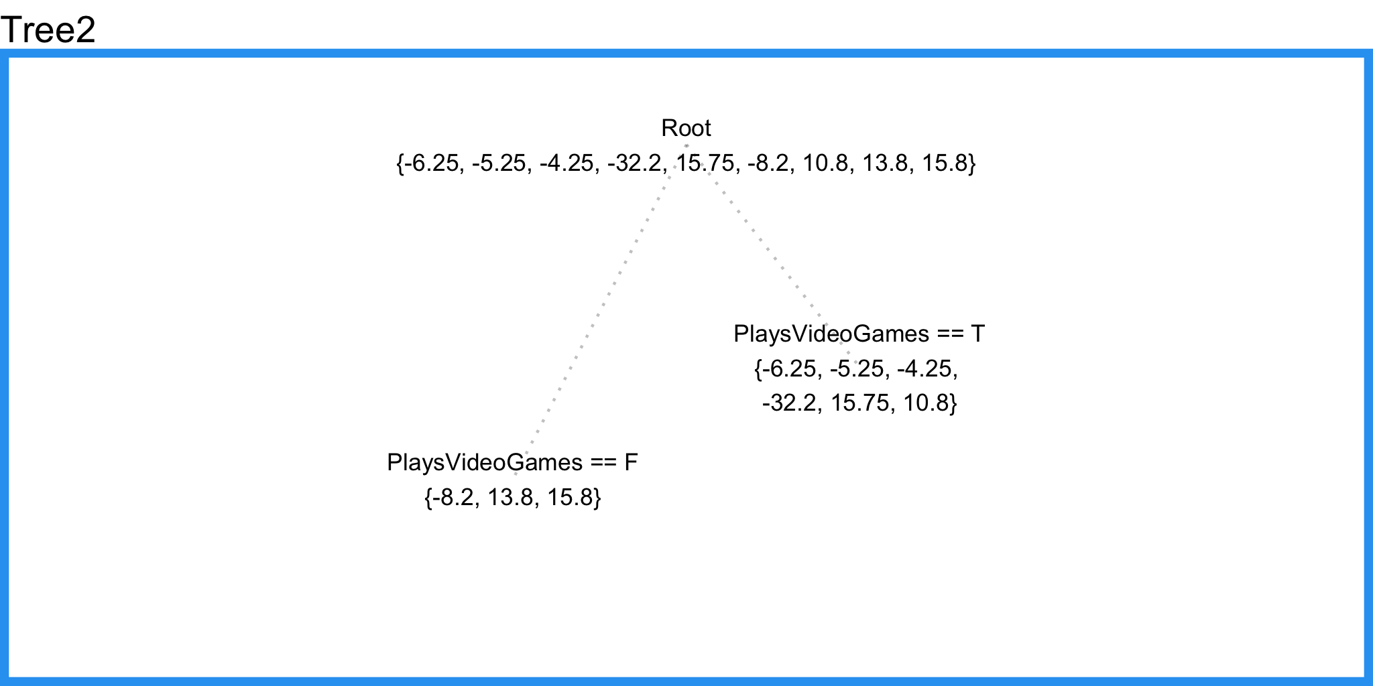
XGBoost
PersonID | Age | Tree1 Prediction | Tree1 Residual | Tree2 Prediction | Combined Prediction | Final Residual
1 | 13 | 19.25 | -6.25 | -3.57 | 15.68 | 2.68
2 | 14 | 19.25 | -5.25 | -3.57 | 15.68 | 1.68
3 | 15 | 19.25 | -4.25 | -3.57 | 15.68 | 0.68
4 | 25 | 57.2 | -32.2 | -3.57 | 53.63 | 28.63
5 | 35 | 19.25 | 15.75 | -3.57 | 15.68 | -19.32
6 | 49 | 57.2 | -8.2 | 7.13 | 64.33 | 15.33
7 | 68 | 57.2 | 10.8 | -3.57 | 53.63 | -14.37
8 | 71 | 57.2 | 13.8 | 7.13 | 64.33 | -6.67
9 | 73 | 57.2 | 15.8 | 7.13 | 64.33 | -8.67
MSE.Tree1 | 1993.55
MSE.Combined | 1764.57
Reference - https://www.gormanalysis.com/

